Slide 1
Without modern medical intervention, how many times would you have died by now?

Slide 2
Communicating Research with Effective Storytelling
AFS2024 Workshop - Day 2
Megumi Oshima & Pavel Dimens

Slide 3
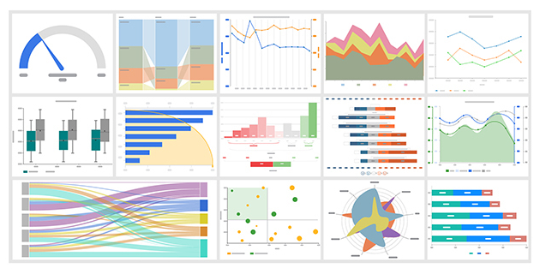
Information
facts
facts, but pictures

Slide 4
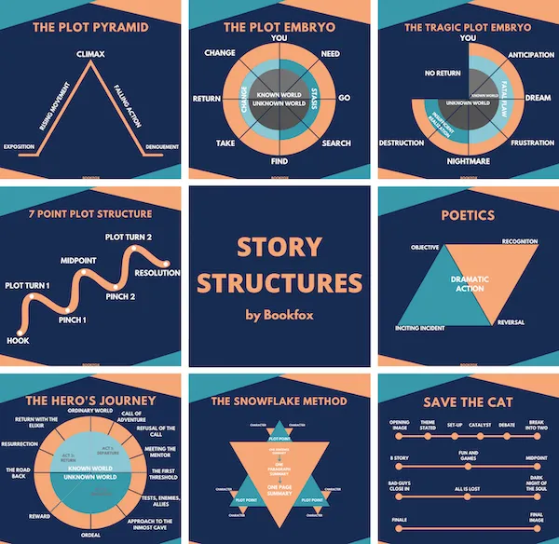
Story
introduction
setting
characters
direction
conflict to resolve

Slide 5
Story about information
introduction
setting
characters
direction
conflict to resolve
where are we
what are we doing
what are we looking at
It’s just worldbuilding ground us

Slide 6
Story
introduction
setting
characters
direction
conflict to resolve
why are you bothering
why should we care
convince us this is cool or important

Slide 7
Story
introduction
setting
characters
direction
conflict to resolve
we need to go somewhere

Slide 8
Direction

Slide 9
Direction
The setup
The rationale
What you did
How it went
Ok cool, what now?
linear flow

Slide 10

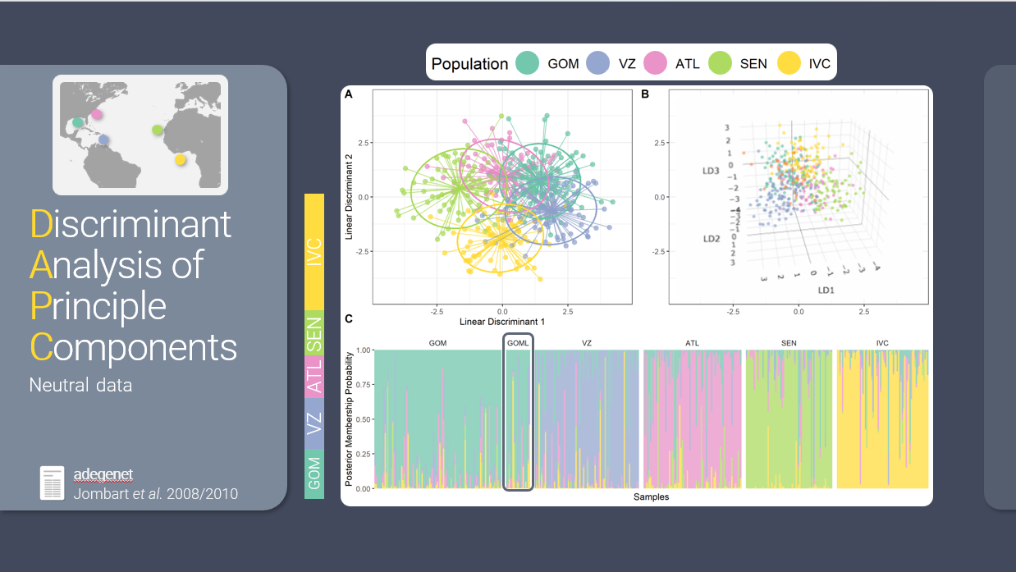
flow
visual
auditory

Slide 11
Exercise

Slide 12

floooooooooow
sound is a stream
sight is a shotgun

Slide 13
5 Minute Break

Slide 14
Aesthetics topics
Fonts
Colors
Less text
Slide Master
Crop To Shape
Insert Icons

Slide 15
5 Minute Break

Slide 16
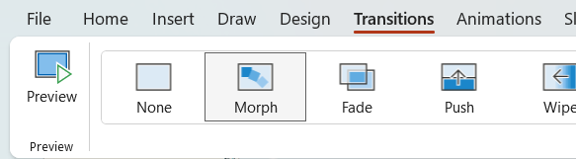
Behold: Morph

Slide 17
Topic Title

Slide 18
Topic Title

Slide 19
Second Topic

Slide 20
Third Topic

Slide 21
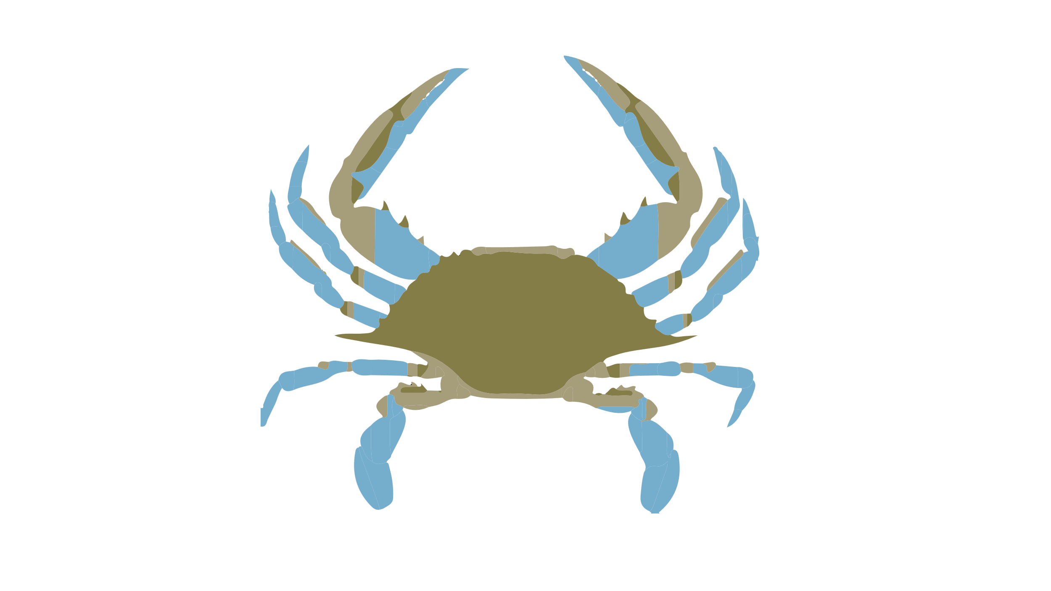
Here are facts
Is this big
Likes to do this
Likes to go here
Hates paprika
Nihilistic
Cyberbully

Slide 22
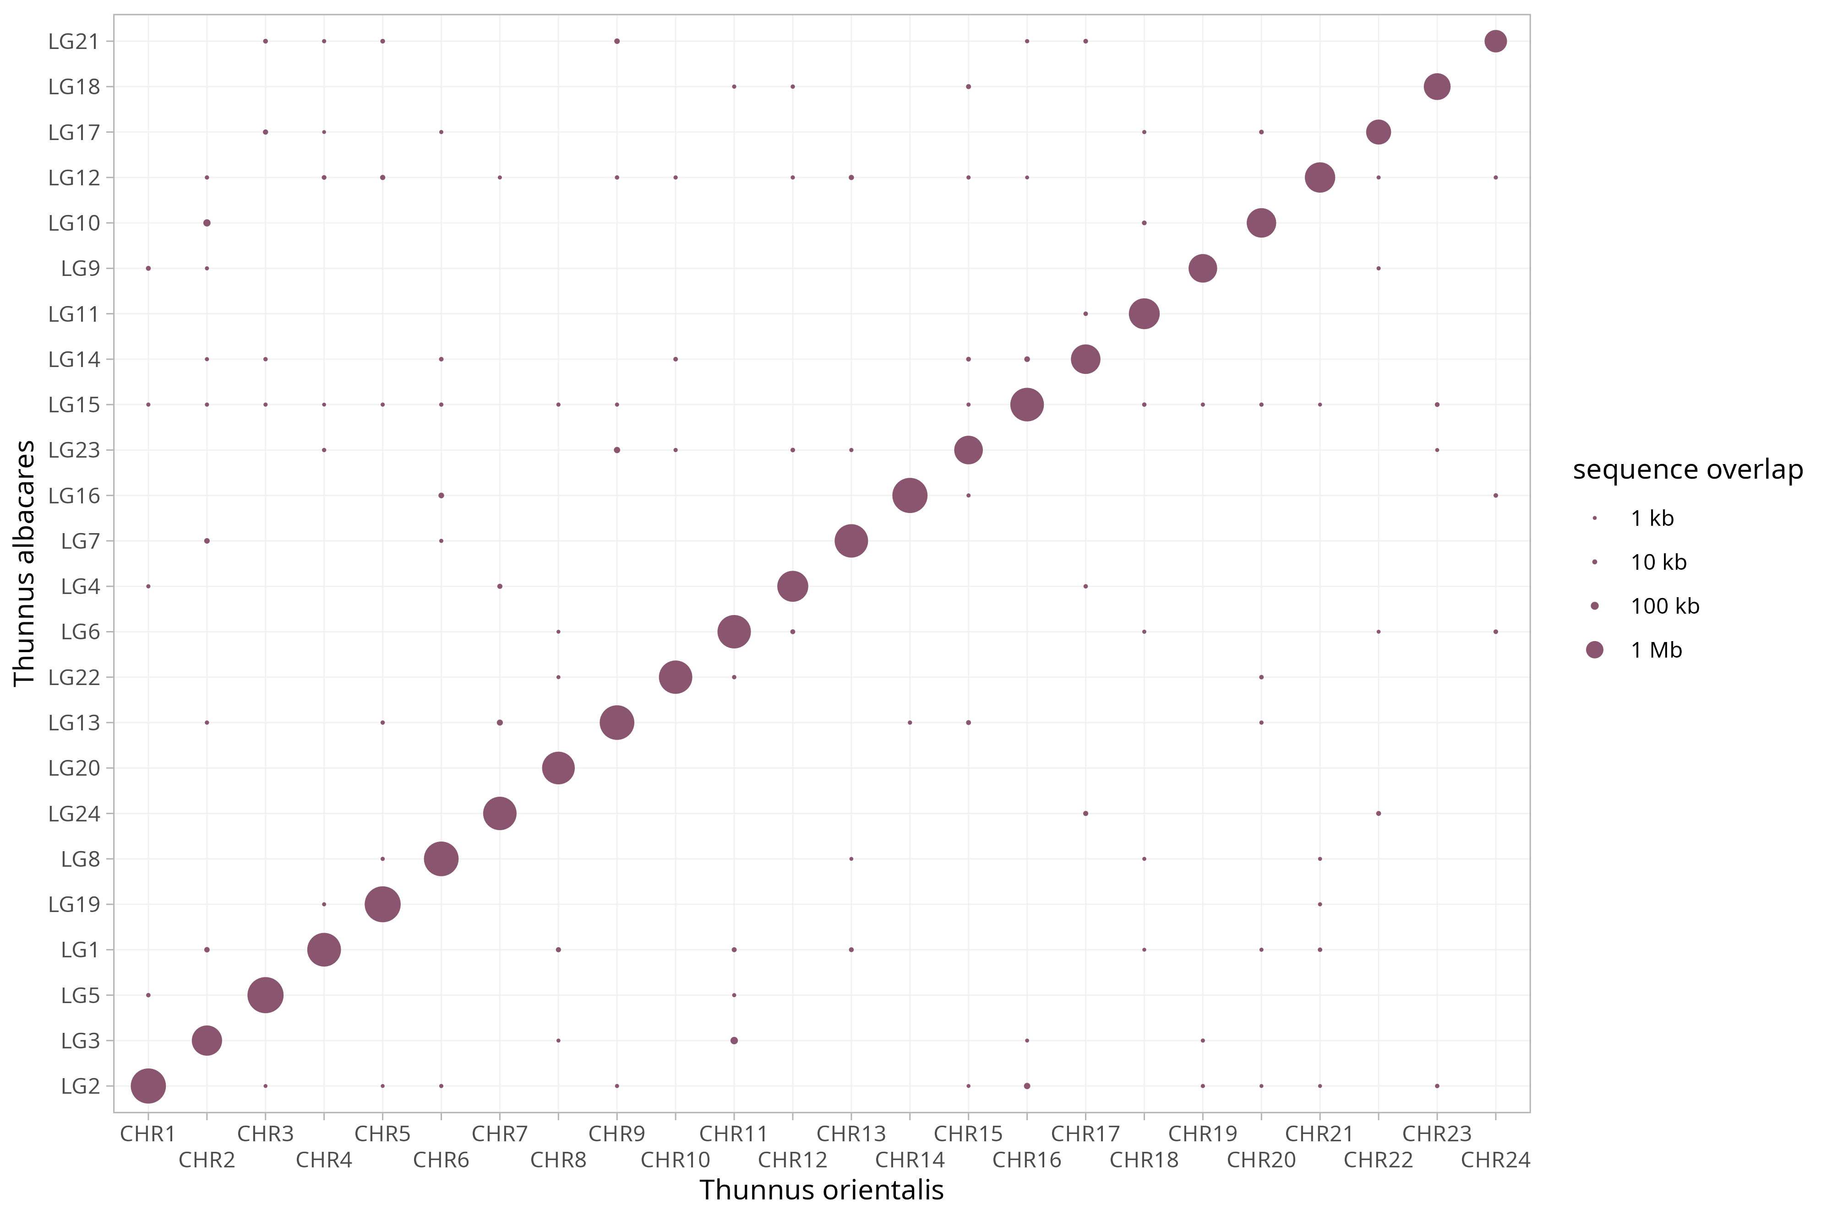
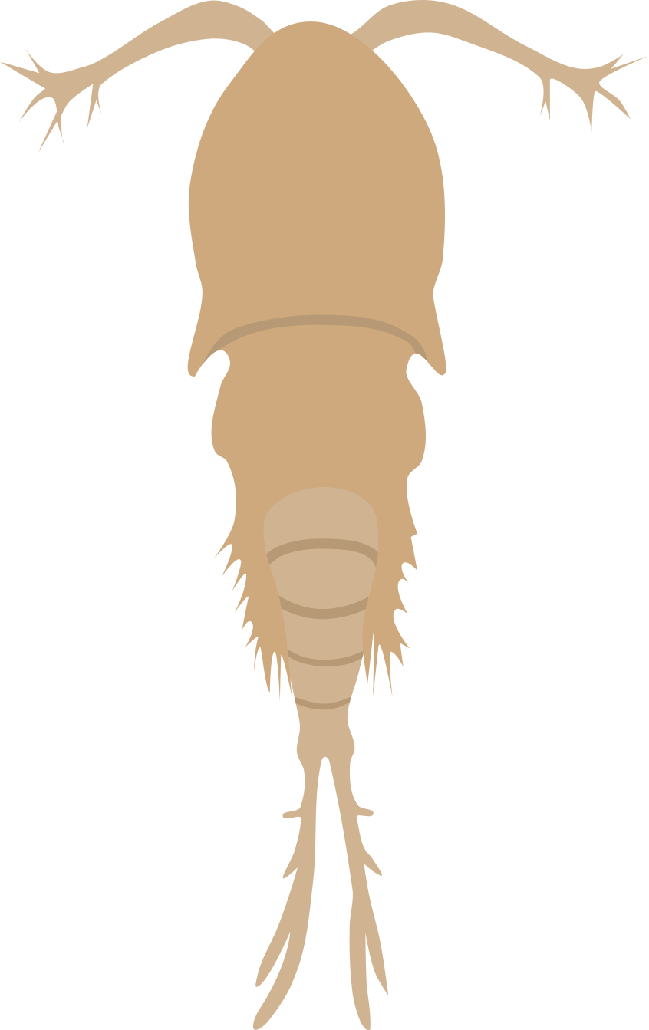
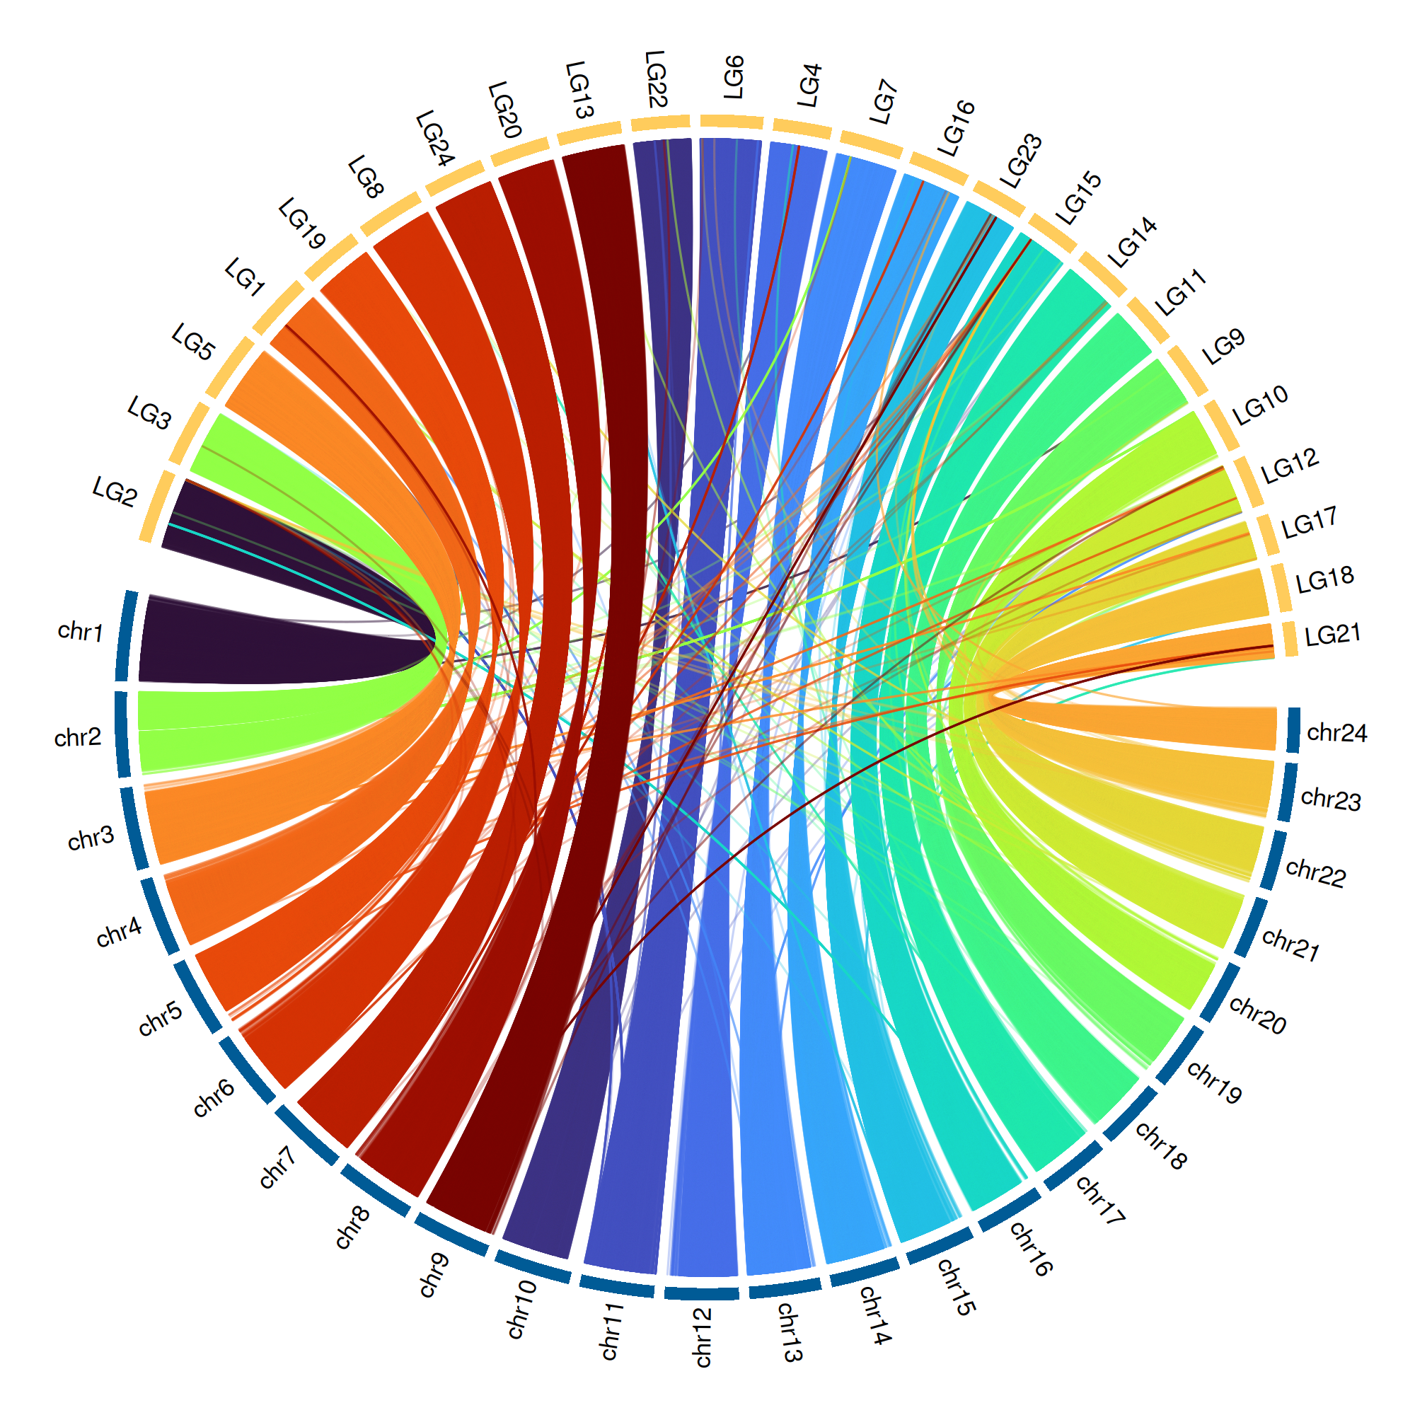
Is this big
Likes to do this
Likes to go here
Hates paprika
Nihilistic
Cyberbully

Slide 24

Appear

Slide 25
Appear

Slide 26

Appear

Slide 27
Appear

Slide 28

Push

Slide 29
Push

Slide 30
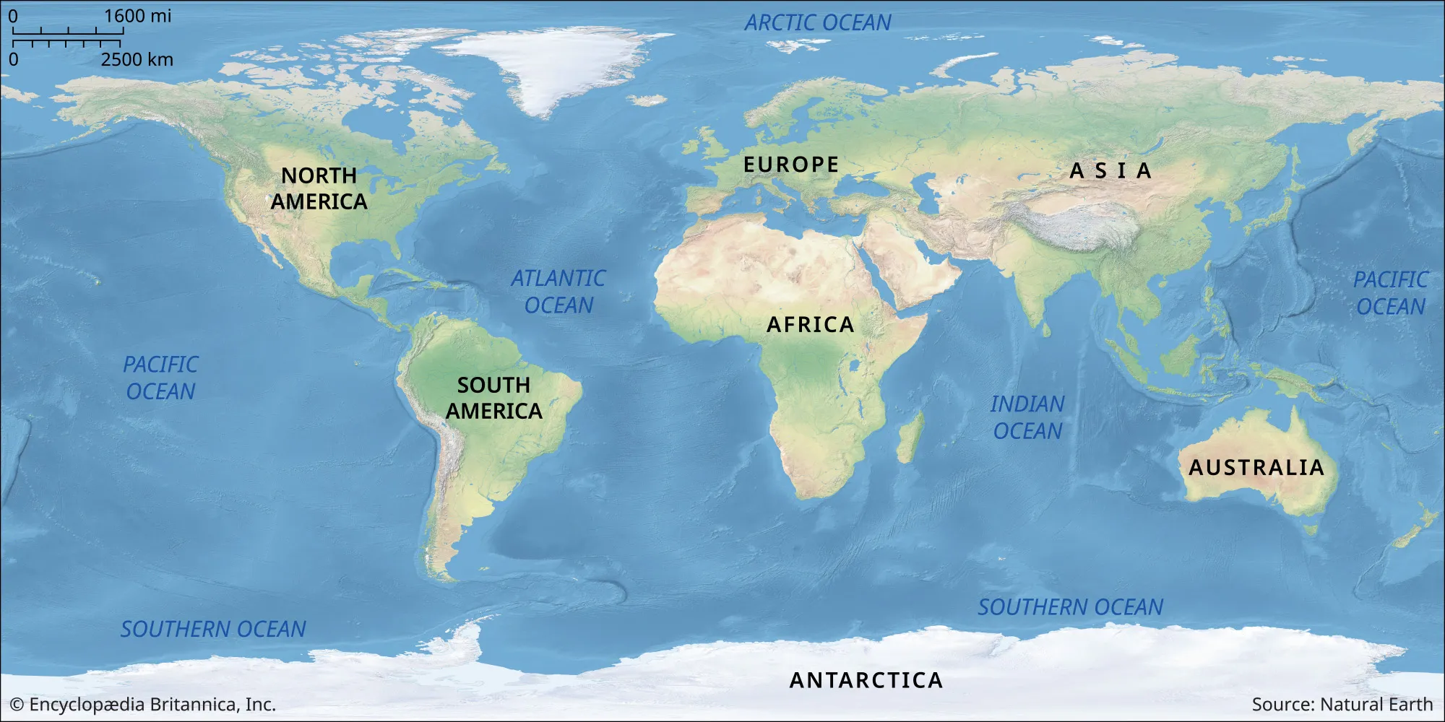
Image Pan

Slide 31
Image Pan

Slide 32
Image Pan

Slide 33
Image Pan

Slide 34
5 Minute Break

Slide 35
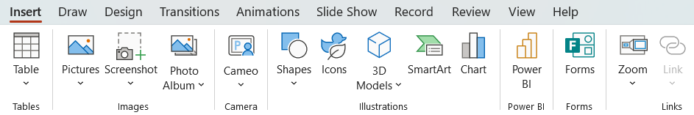
Zoom

Slide 36
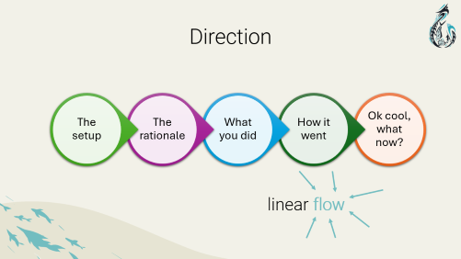
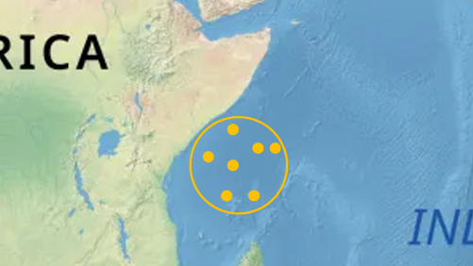
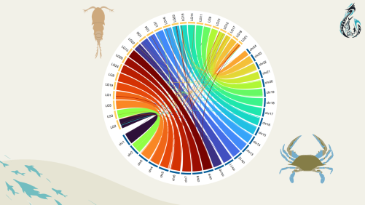
Zoom

Slide 37
Important things are important

Slide 38
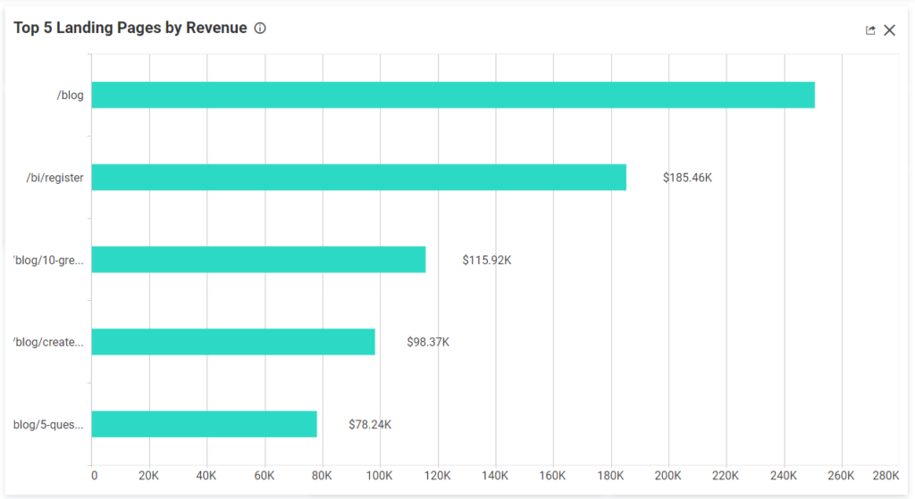
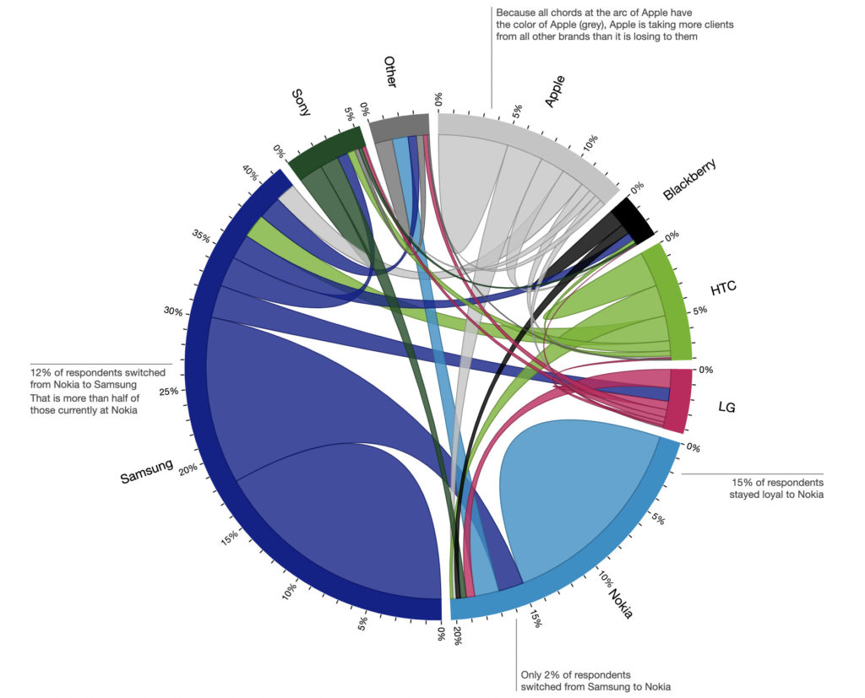
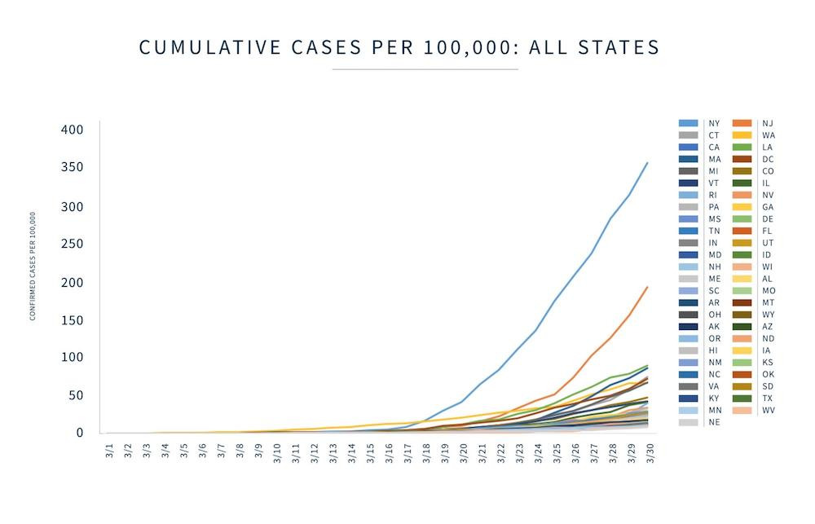
Title
some kind of text
more text about stuff

Slide 39
Title

Slide 40
Title

Slide 41
Title

Slide 42
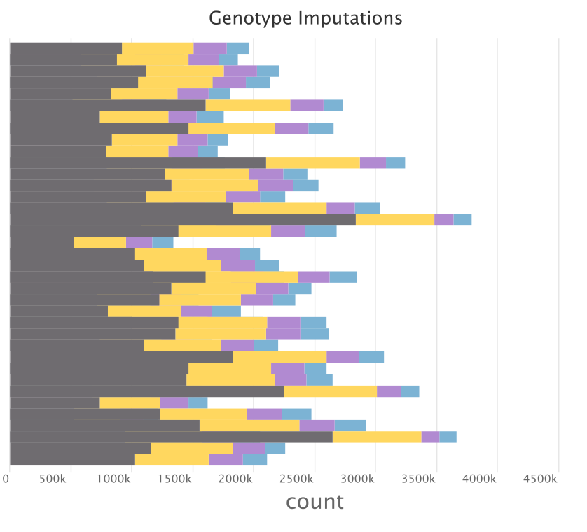
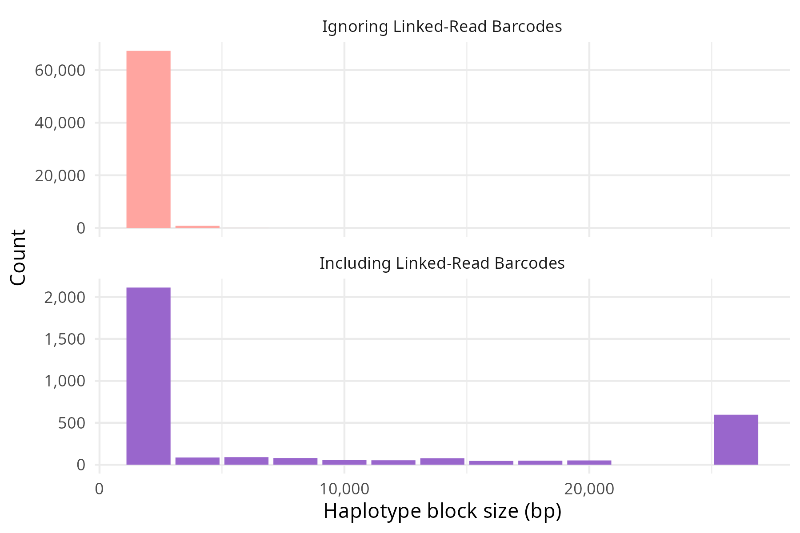
Recover many missing genotypes with linked-read aware imputation
Not Imputed
Hom Ref
Hom Alt
Het
called genotype
Phase SNPs into haplotypes
25kbp+

Slide 43

Recover many missing genotypes with linked-read aware imputation
Phase SNPs into haplotypes
25kbp+
Not Imputed
Hom Ref
Hom Alt
Het
called genotype

Slide 44
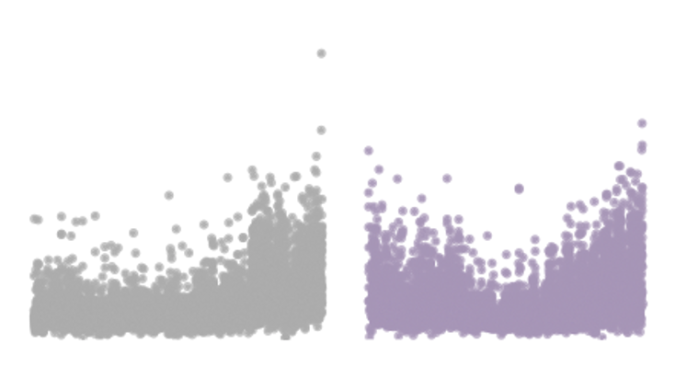
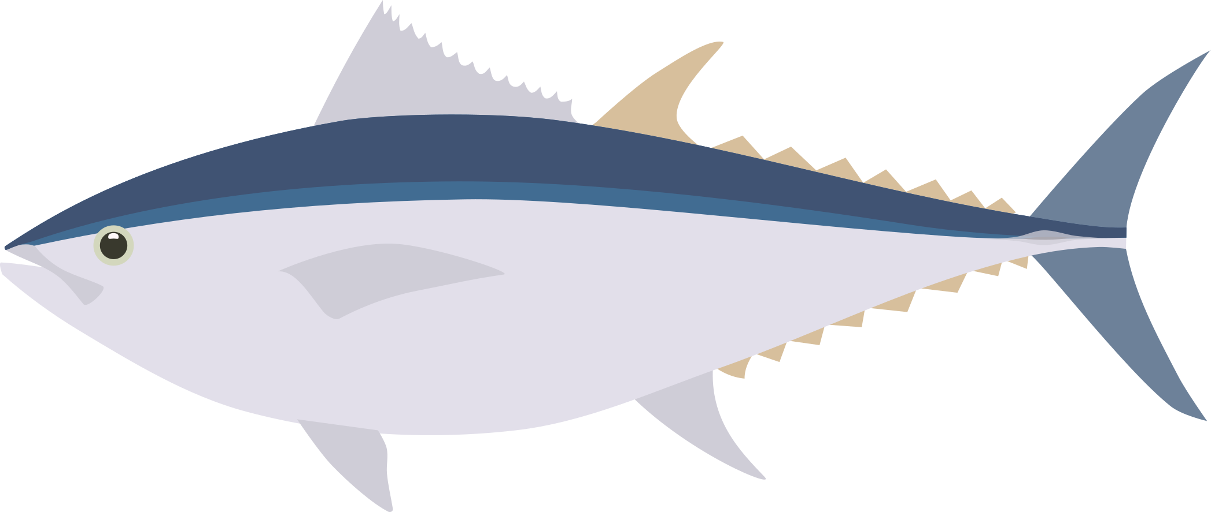

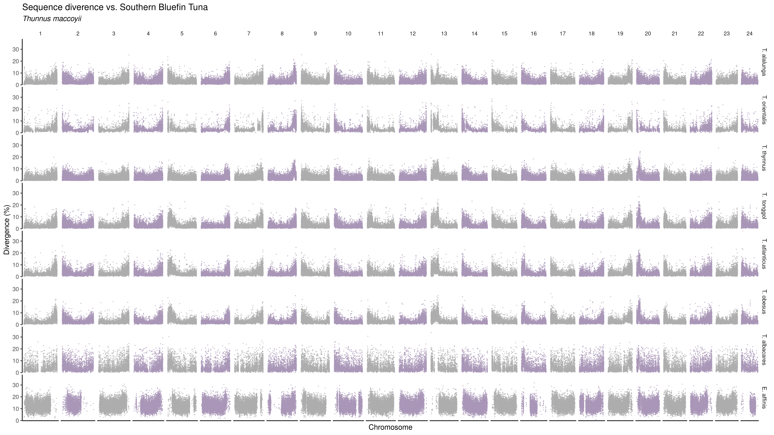
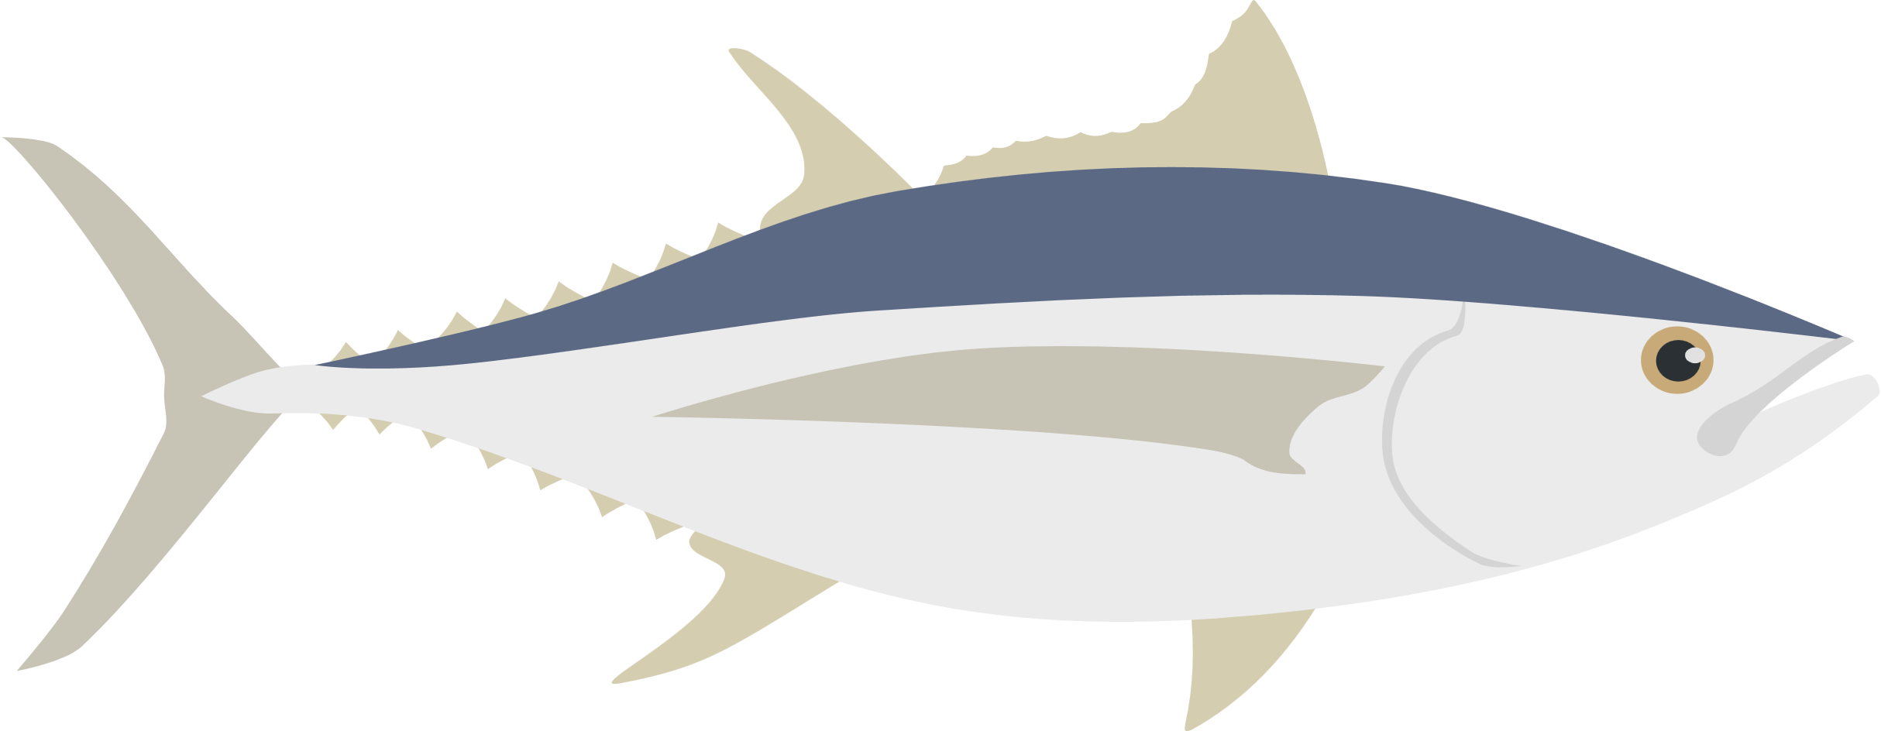
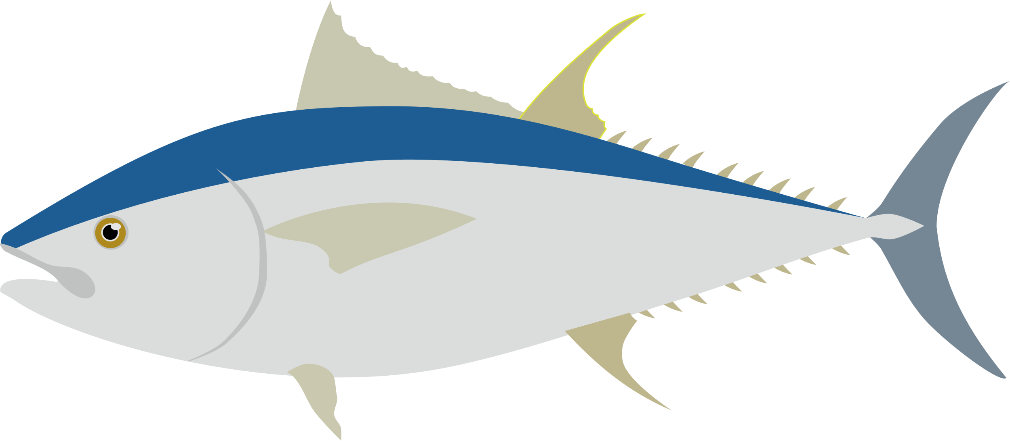
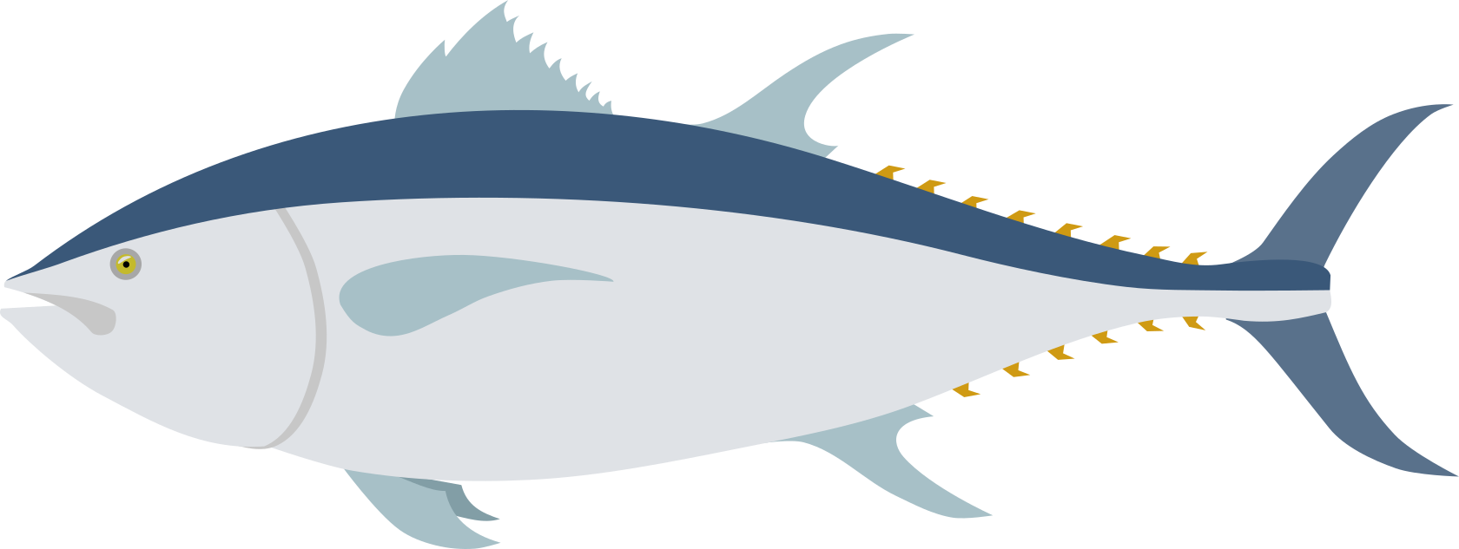
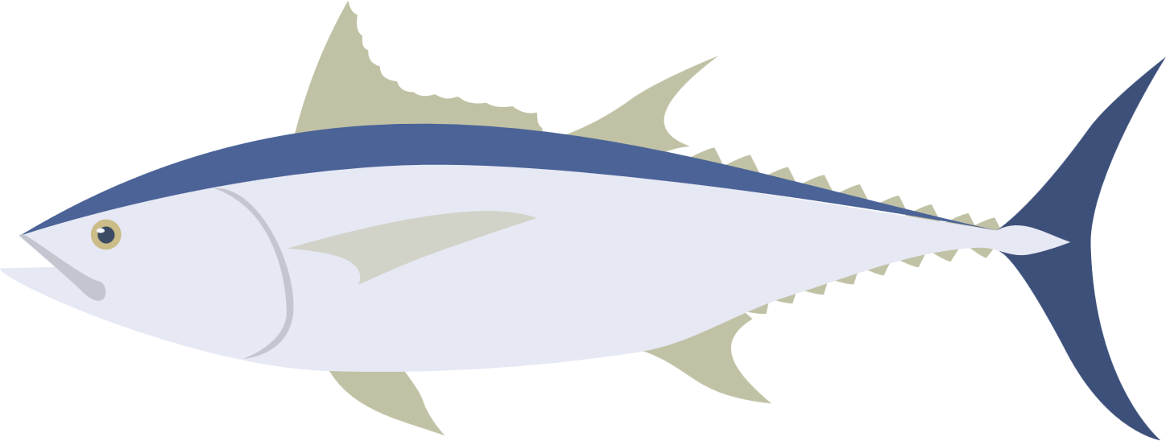

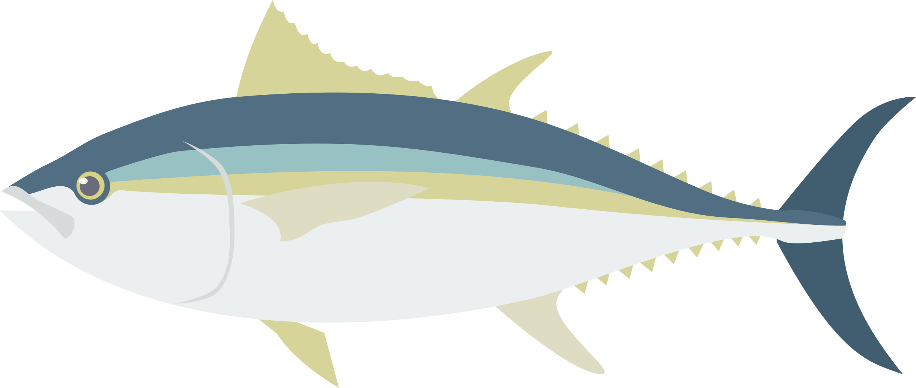

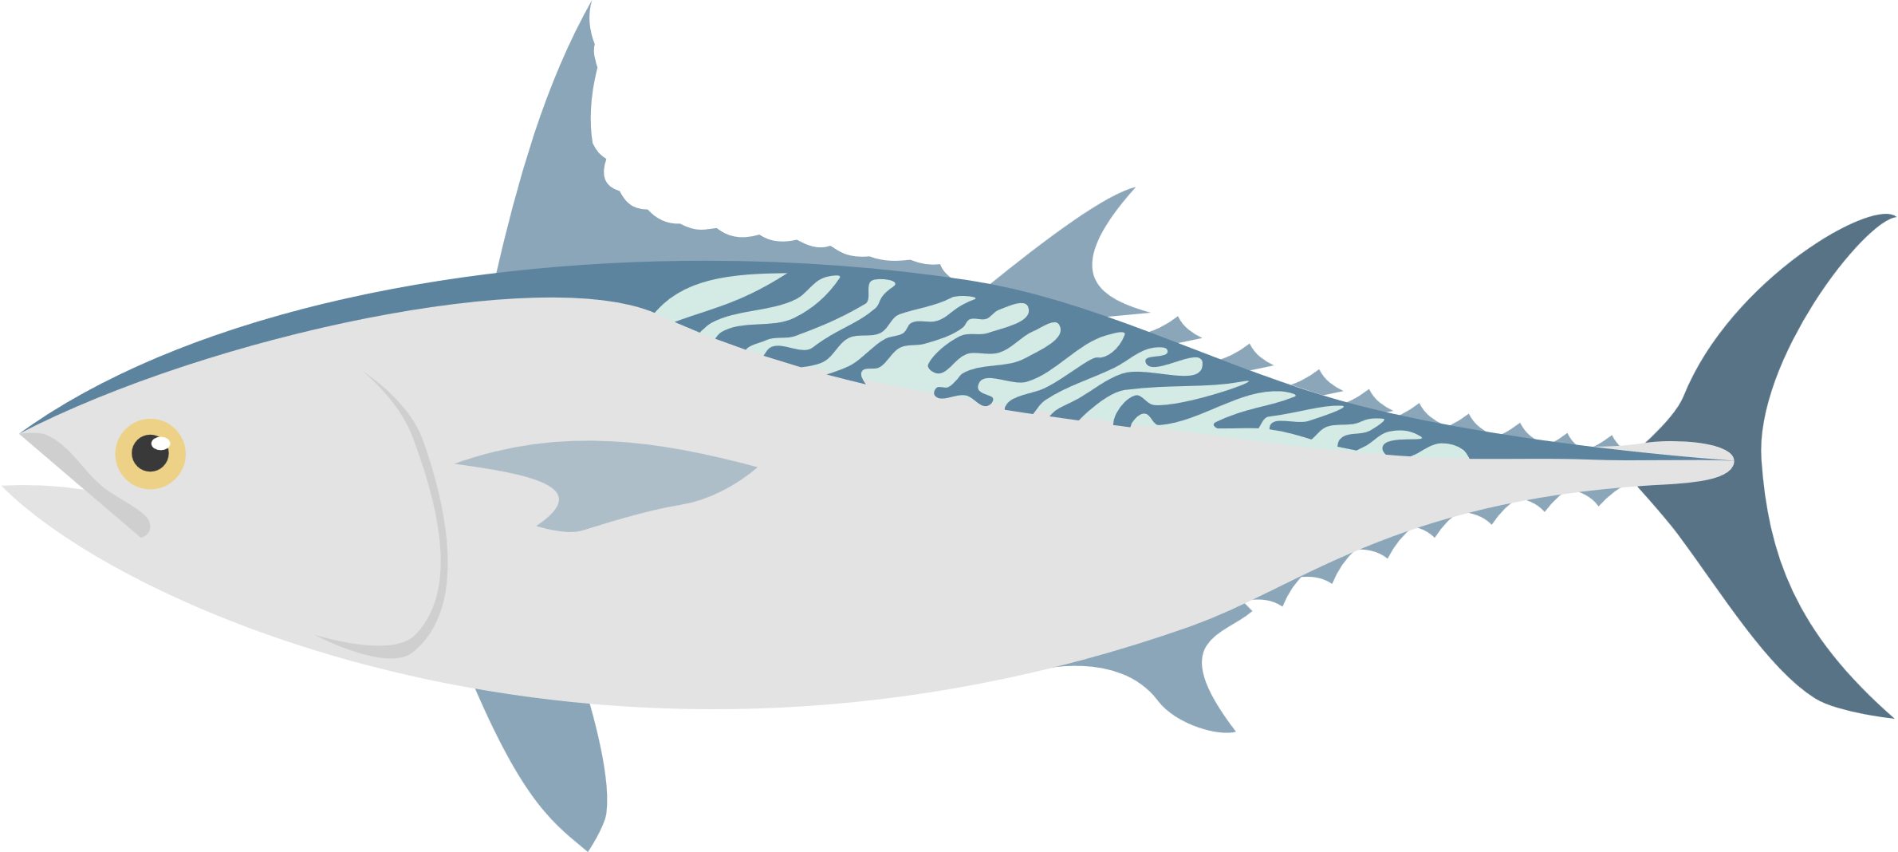
Sequence divergence vs Southern bluefin tuna
Marçaiset al. 2018
Notes:
relationship btwn species
conserved regions
confirm a tree

Slide 45
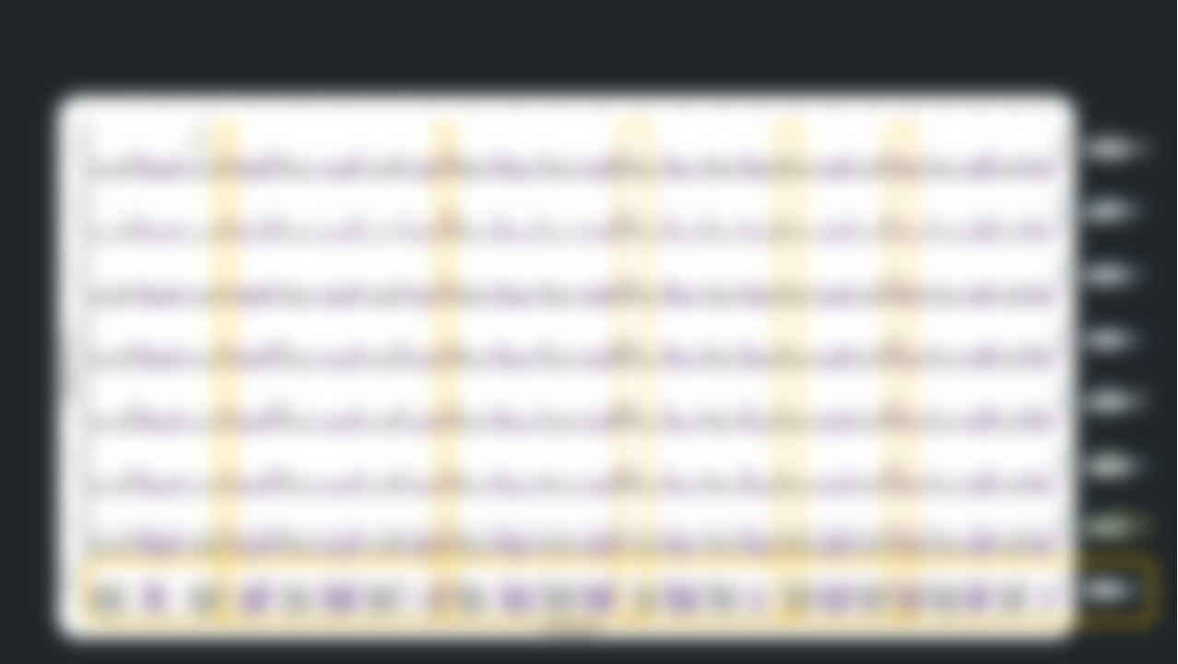
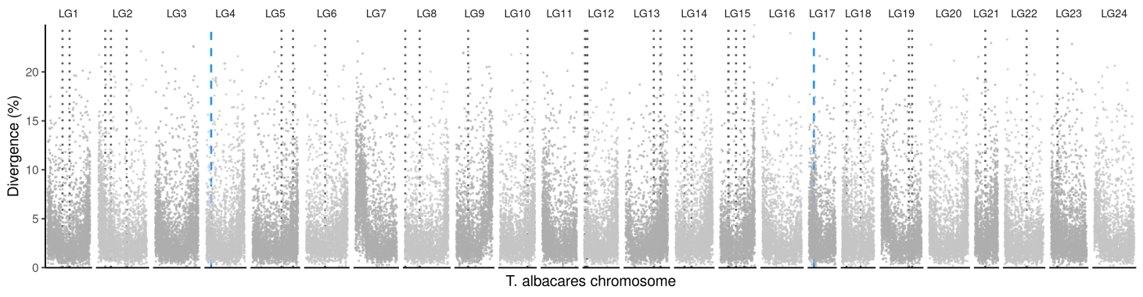




Sequence divergence vs Southern bluefin tuna
Sequence divergence between Yellowfin and Blackfin tuna
Marçaiset al. 2018
Yellowfin tuna
Blackfin tuna
Notes:
relationship btwn species
conserved regions
confirm a tree

Slide 46

Sequence divergence vs Southern bluefin tuna
Sequence divergence between Yellowfin and Blackfin tuna
Marçaiset al. 2018
Centromere?
Telomere?
Notes:
relationship btwn species
conserved regions
confirm a tree

Slide 47
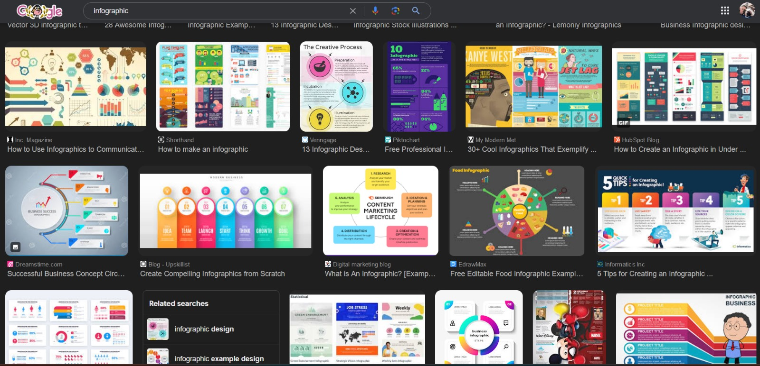
Look at what the pros are doing

Slide 48
5 Minute Break

Slide 49



Group Project
Fix these terrible presentations

